Slide 1



DEPARTMENT OF INFORMATION SCIENCE AND ENGINEERING
MAJOR PROJECT PHASE II PRESENTATION
ON
“Bidirectional Indian Sign Language Translator Using Gesture Recognition”
PRESENTED BY
NIHARIKA P 1VK22IS038
PADMAJA 1VK22IS040
CHANDANA TN 1VK23IS401
UNDER THE GUIDANCE OF
MR.RAHUL J
ASST PROFESSOR, DEPT OF ISE-VKIT
https://vitb.ac.in/

Slide 2




AGENDA
Introduction
Problem Statement
Literature Survey
Objectives
Methodology
Architectural Design
Implementation details of modules
Data flow Diagram
Interface Diagram
Test case with results
Results
Conclusions
References
DEPT OF ISE, VKIT
https://vitb.ac.in/

Slide 3
INTRODUCTION
Hiring teams receive hundreds of resumes for every opening, and screening them manually is slow, inconsistent and hard to scale.
Most Applicant Tracking Systems (ATS) only count keyword matches, so they reward keyword stuffing and cannot tell that FastAPI and Flask are related skills.
Automated screening is also under scrutiny for bias, and the EU AI Act treats recruitment AI as high-risk, so every decision must be explainable.
In this project (Phase 2) we developed an explainable, bias-aware screening system that ranks candidates on seven weighted signals, hides identity during scoring and gives a reason for every verdict.
DEPT OF ISE, VKIT
https://vitb.ac.in/

Slide 4
PROBLEM STATEMENT
Keyword-based ATS tools, like our Phase 1 system, only answer whether a resume contains the words of a job description. They cannot judge whether a skill claim is backed by evidence, they give no explanation when a candidate is rejected, and they can carry hidden bias from names and personal details. As a result, recruiters lose good candidates, trust inflated resumes and cannot justify their decisions. There is a need for a screening system that is accurate, explainable and bias-aware, so that hiring decisions are fair, consistent and auditable.
DEPT OF ISE, VKIT
https://vitb.ac.in/

Slide 5
LITERATURE SURVEY
Sl.No | Title | Author | Contribution | Drawback
1 | Enhancing Person-Job Fit for Talent Recruitment: An Ability-Aware Neural Network Approach | C. Qin, H. Zhu, T. Xu, et al. | A neural network that learns the abilities a job requires and matches them with the abilities shown in a resume, improving person-job fit prediction. | The learned model gives a match score without a human-readable reason and needs large amounts of historical hiring data.
2 | End-to-End Resume Parsing and Finding Candidates for a Job Description Using BERT | V. Bhatia, P. Rawat, A. Kumar, R. R. Shah | Extracts structured fields from resumes with BERT and ranks candidates against a job description in one pipeline. | Produces a single similarity score, with no skill-gap breakdown and no check for bias.
DEPT OF ISE, VKIT
https://vitb.ac.in/

Slide 6
Sl.No | Title | Author | Contribution | Drawback
3 | Comparing BERT and Sentence-BERT for Automated Resume Screening | A. Deshmukh, A. R. Dahake | Compares BERT and Sentence-BERT embeddings for matching resumes to job descriptions. | Evaluates similarity quality only; explanation of the result and fairness are not addressed.
4 | Sentence-BERT: Sentence Embeddings using Siamese BERT-Networks | N. Reimers, I. Gurevych | Produces fast sentence embeddings that capture meaning, so "built REST services" matches "developed HTTP APIs". | A general text-similarity tool; it needs extra logic for skills, experience and fair decision-making.
5 | Gender, Race, and Intersectional Bias in Resume Screening via Language Model Retrieval | K. Wilson, A. Caliskan | Audits language-model resume retrieval and shows that it can favour some names and groups over others. | An audit only; it does not propose a screening system that removes the bias.
DEPT OF ISE, VKIT
https://vitb.ac.in/

Slide 7
Sl.No | Title | Author | Contribution | Drawback
6 | The Silicon Ceiling: Auditing GPT's Race and Gender Biases in Hiring | L. Armstrong, A. Liu, S. MacNeil, D. Metaxa | Shows that GPT-based hiring prompts can produce race- and gender-biased outcomes. | An audit only; no bias mitigation is built into a working pipeline.
7 | Mitigating Bias in Algorithmic Hiring: Evaluating Claims and Practices | M. Raghavan, S. Barocas, J. Kleinberg, K. Levy | Examines the bias-mitigation claims made by hiring-algorithm vendors and evaluates them against technical and legal requirements. | An analysis of existing practice; it does not implement a screening system.
8 | FA*IR: A Fair Top-k Ranking Algorithm | M. Zehlike, F. Bonchi, C. Castillo, S. Hajian, M. Megahed, R. Baeza-Yates | A re-ranking algorithm that keeps the top-k results fair to a protected group. | Needs protected attributes at ranking time and does not explain why a candidate received a score.
DEPT OF ISE, VKIT
https://vitb.ac.in/

Slide 8
Sl.No | Title | Author | Contribution | Drawback
9 | Improving Factuality and Reasoning in Language Models through Multiagent Debate | Y. Du, S. Li, A. Torralba, J. B. Tenenbaum, I. Mordatch | Several language-model agents debate and refine their answers, which improves reasoning and reduces errors. | Studied on general reasoning tasks, not on hiring decisions, and costs more computation.
10 | A Comprehensive Survey of Artificial Intelligence Techniques for Talent Analytics | C. Qin, et al. | Surveys AI techniques used across talent analytics, such as recruitment, including matching and ranking methods. | A survey; it does not provide an implemented, explainable and bias-aware screening pipeline.
Research gap: existing work is either accurate but a black box, or an audit of bias with no fix. None combines semantic ranking, skill-synonym understanding, blind screening and a multi-agent explanation in one system.
DEPT OF ISE, VKIT
https://vitb.ac.in/

Slide 9
OBJECTIVES
1. To Design: an explainable screening workflow that shows why every candidate was ranked and which skills are missing.
2. To Implement: a hybrid ranker that combines skills, semantic fit, experience, education, projects, certifications and resume quality.
3. To Build: a skill-synonym ontology with skill-gap analysis that shows matched, partial and missing skills.
4. To Minimize: bias with a blind-screening mode that hides names and personal details before any scoring.
5. To Accomplish: fast, auditable hiring decisions through a four-agent review council and a FastAPI service.
DEPT OF ISE, VKIT
https://vitb.ac.in/

Slide 10
METHODOLOGY
1 Input
Job description + resumes (PDF, DOCX, TXT, scanned)
2 Parsing
Skills, experience, education, projects
3 Blind Screening
Name and personal details hidden
4 Skill Ontology
Synonyms and partial matches
8 Recruiter Dashboard
Leaderboard, compare, export
7 Explainable Verdict
Score, red flags, rationale
6 Council Review
Four agents score and debate
5 Hybrid Ranking
Seven weighted scores give match %
Every stage is logged in the screening history, so each ranking can be audited later.
DEPT OF ISE, VKIT
https://vitb.ac.in/

Slide 11
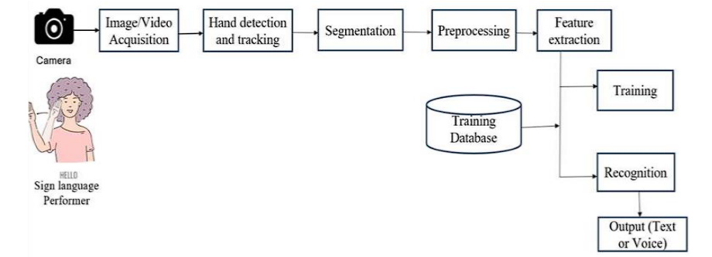
ARCHITECTURAL DESIGN
Presentation
React web app
Nexus ATS (Vercel)
Streamlit app
Recruiter workspace
Recruiter dashboard
Leaderboard, interview kit, chatbot
Service
FastAPI REST service
Screening engine and accounts (Render)
Secure sign-in
Hashed passwords, 7-day sessions, Google verified on the server
Intelligence engine
Resume parser
PDF, DOCX, TXT, OCR
Skill ontology
Synonyms, partial credit
Hybrid ranker
7 weighted scores
Four-agent council
Verdict + red flags
Interview kit
20+ tailored questions
Data
MongoDB Atlas
Accounts, sessions, candidate pools
SQLite history
Screening runs, audit trail
Job roles
Required and preferred skills
DEPT OF ISE, VKIT
https://vitb.ac.in/

Slide 12
IMPLEMENTATION
Job Description
Pasted by the recruiter
Resume Upload
PDF, DOCX, TXT, scanned (OCR)
Input: the job description and resumes are parsed into structured profiles.
Fairness: blind screening hides identity before any scoring.
Scoring: the ontology feeds a ranker that blends seven signals.
Decision: four agents score, debate and give a verdict with red flags.
Output: leaderboard, skill gap, a 20-question interview kit and a chatbot; the engine is served through FastAPI, with accounts and candidate pools in MongoDB Atlas.
JD Parser
Required and preferred skills
Resume Parser
Skills, experience, education, projects
Blind Screening (optional)
Names and contact details replaced by Candidate #00N
Skill Ontology
Synonyms, partial credit
Hybrid Ranker
7 weighted scores = match %
Verdict + Dashboard
Skill gap, interview kit, chatbot
Four-Agent Council
Tech Lead, Culture, Fair Auditor, Seniority
DEPT OF ISE, VKIT
https://vitb.ac.in/

Slide 13
HYBRID RANKING MODEL
Match % is the weighted sum of seven scores, each from 0 to 100.
Skills (35%): required skills are matched through the ontology; related skills get partial credit (FastAPI through Flask counts 0.5).
Semantic fit (20%): TF-IDF and BM25 offline, Sentence-BERT when installed.
Evidence weighting: a skill that is listed but never shown in a project or result counts for less.
Flags: experience deficit, skill stuffing and date inconsistency lower the verdict.
DEPT OF ISE, VKIT
https://vitb.ac.in/

Slide 14
FOUR-AGENT COUNCIL AND EXPLAINABILITY
Tech Lead: checks skill coverage, evidence and architecture signals.
Culture: judges stability and retention risk.
Fair Auditor: checks that the decision is neutral and bias-free.
Seniority and Compensation: compares experience with the role level.
Consensus: the agents cross-examine each other, then give one verdict (Strong Hire, Lean Hire or Reject) with red flags and a debate transcript.
DEPT OF ISE, VKIT
https://vitb.ac.in/

Slide 15
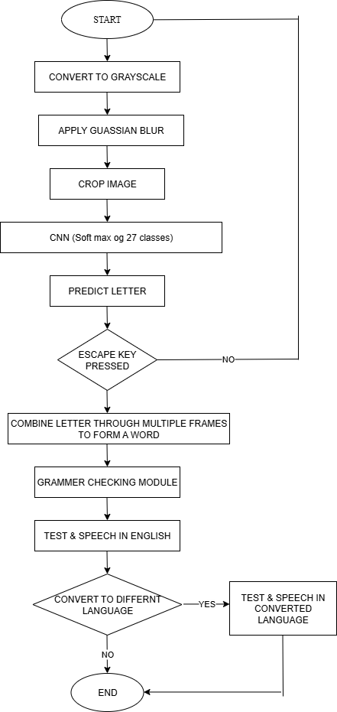
DATA FLOW DIAGRAM
Resume screening flow:
Recruiter signs in, uploads JD + resumes
The recruiter signs in and uploads the job description and the resumes.
Each resume is parsed into skills, experience, education, projects and certifications.
Blind screening, when switched on, hides the name and personal details.
Every candidate is scored on seven signals using the skill ontology.
The four-agent council reviews the scores and gives a verdict with red flags.
Results are shown on the dashboard, and the API also saves them to the screening history.
Resume parsing
Blind screening (optional)
Scoring on 7 signals
Council verdict + flags
Dashboard + saved history
DEPT OF ISE, VKIT
https://vitb.ac.in/

Slide 16
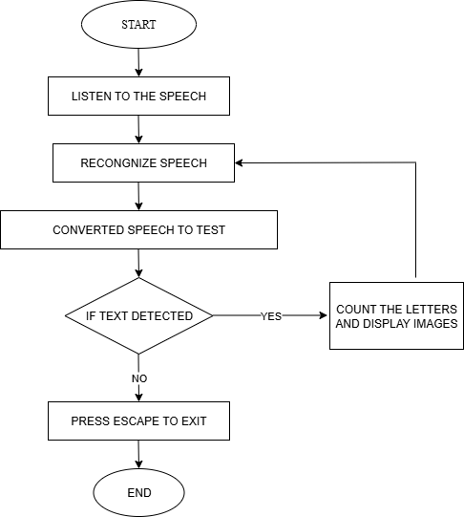
Council decision flow:
Scored candidate profile
The scored candidate profile, anonymised when blind screening is on, is sent to the council.
Four agents score it independently: Tech Lead, Culture, Fair Auditor and Seniority.
The agents debate and cross-examine each other's findings.
A consensus score and a confidence value are calculated.
The verdict (Strong Hire, Lean Hire or Reject) is issued with red flags and a rationale.
Low-confidence cases are marked for human review.
Tech Lead
Culture
Fair Auditor
Seniority
Debate and cross-examination
Consensus score + confidence
Verdict + red flags
Low confidence: human review
DEPT OF ISE, VKIT
https://vitb.ac.in/

Slide 17
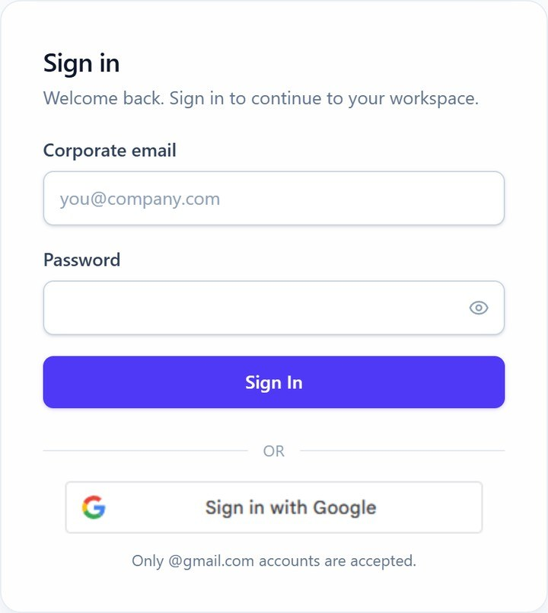
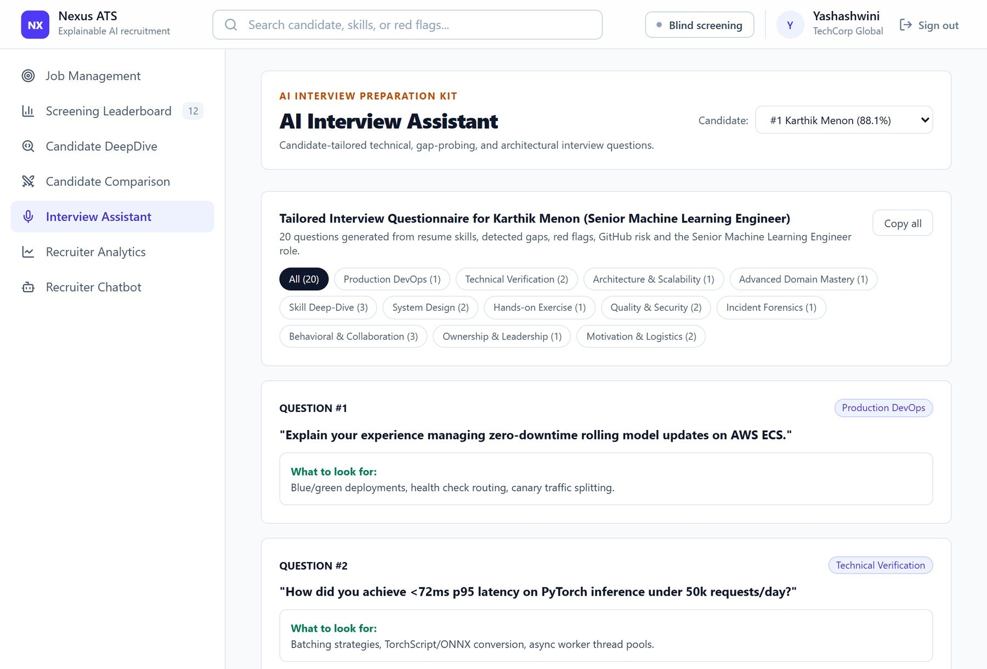
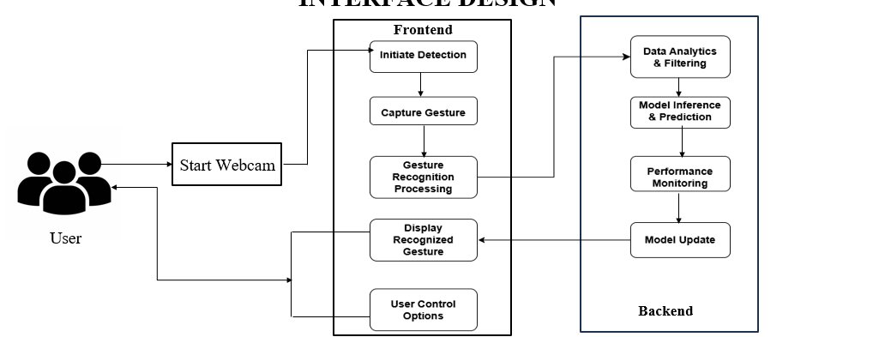
INTERFACE DESIGN
Sign-in (live site)
Interview assistant: tailored question kit
DEPT OF ISE, VKIT
https://vitb.ac.in/

Slide 18
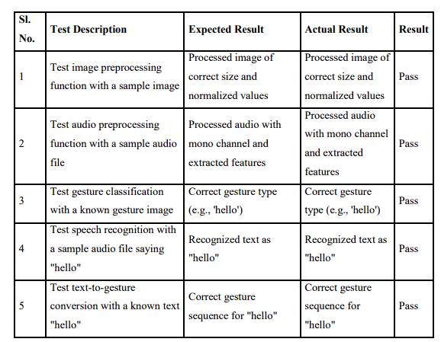
TEST CASES WITH RESULTS
Test resume | Scenario | Expected result | Actual result | Result
Gold Standard | Strong ML engineer with evidence of results | Rank 1, match at least 85%, STRONG HIRE, no red flags | Rank 1, match 88.1%, ATS 100, STRONG HIRE; flags: none | PASS
Buzzword Exaggeration | 35 listed skills, 4 months of experience, no metrics | Match below 45%, REJECT, unverified-claims and experience flags | Rank 10, match 41.6%, ATS 56, REJECT; flags: Experience Deficit, Unverified Skill Claims, Skill Stuffing | PASS
Lateral Partial Match | Flask developer; FastAPI credited through Flask | LEAN HIRE; FastAPI partial match; PyTorch missing | Rank 3, match 61.3%, ATS 92, LEAN HIRE; flags: Required Skills Missing | PASS
Corrupt ATS Format | Damaged layout and inconsistent dates | ATS score below 35 and a date-inconsistency flag | Rank 11, match 34.0%, ATS 23, REJECT; flags: No Quantified Impact, Date Inconsistency | PASS
4 of 4 test resumes passed on the real pipeline (no mock data). These four are part of the automated suite: 78 tests in total (49 Python and 29 JavaScript), all passing.
DEPT OF ISE, VKIT
https://vitb.ac.in/

Slide 19
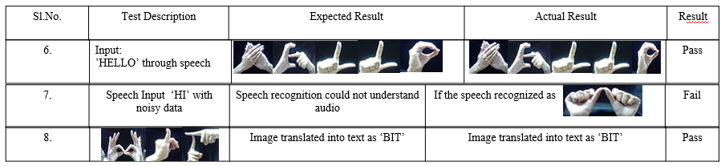
TEST CASES WITH RESULTS (CONTD.)
Test resume | What it checks | Phase 1 keyword score | Phase 2 hybrid score | Council score
Gold Standard | No inflated perfect score for a strong candidate | 100.0 | 88.1 | 91.4
Buzzword Exaggeration | Stuffed skills are not rewarded | 47.1 | 41.6 | 50.3
Lateral Partial Match | Related skills earn partial credit | 47.1 | 61.3 | 76.0
Corrupt ATS Format | Damaged resume is still scored and flagged | 0.0 | 34.0 | 38.5
Fairness test: swapping a candidate's name changed no score (maximum change 0.0) in plain or blind mode.
Ablation: without evidence weighting, two REJECT verdicts would have become LEAN HIRE.
DEPT OF ISE, VKIT
https://vitb.ac.in/

Slide 20
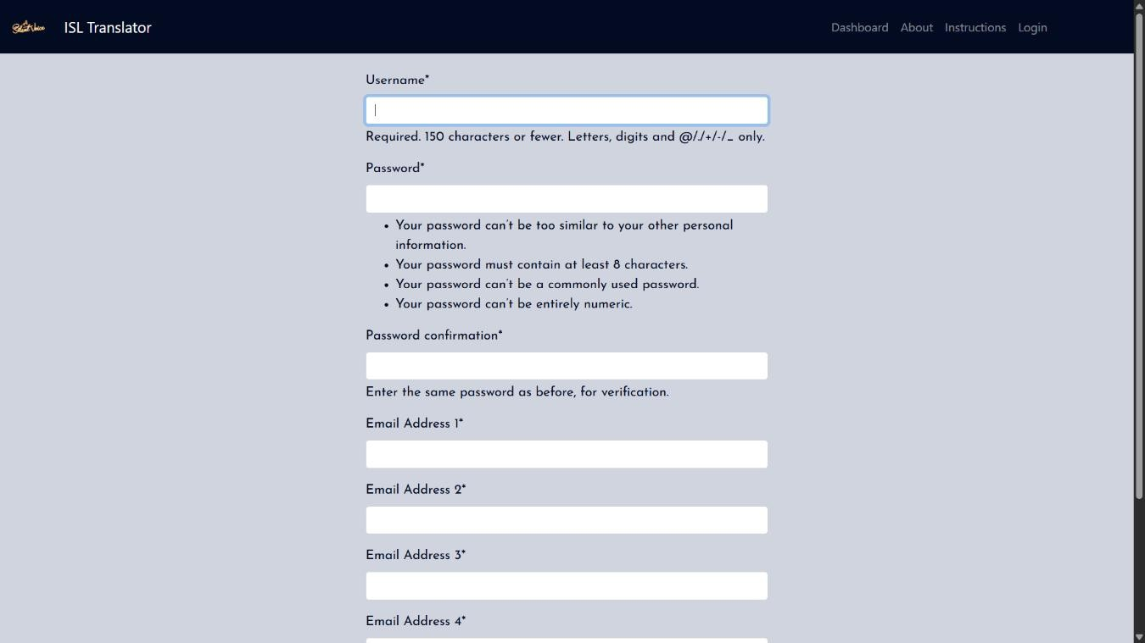
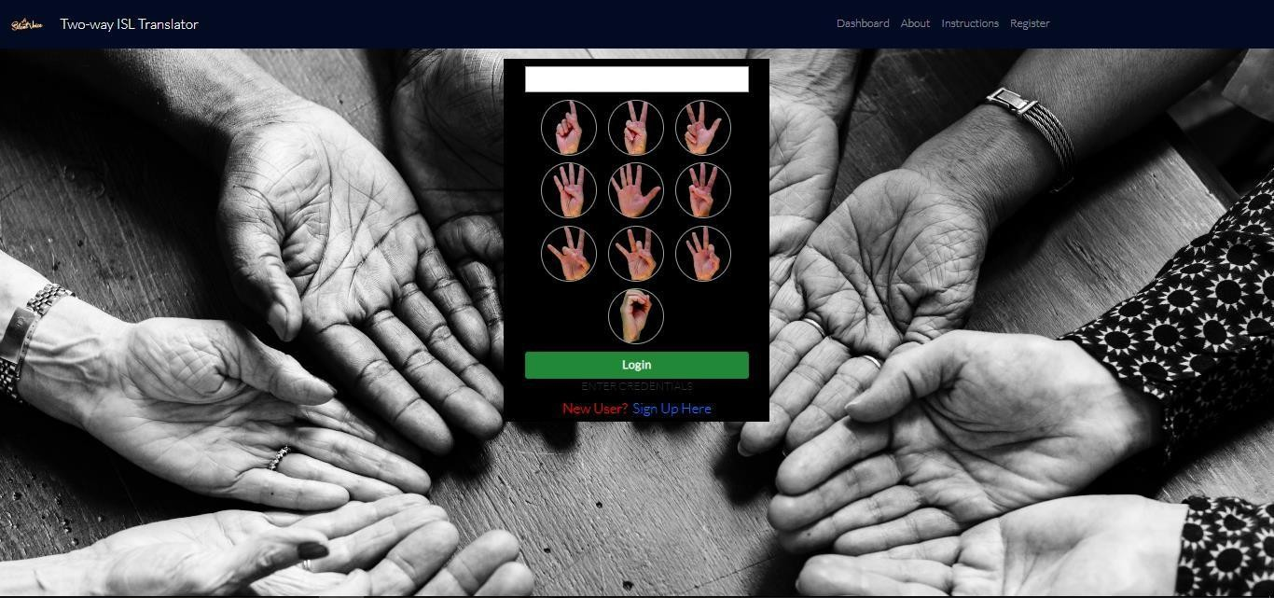
RESULTS
88.1%
top match score, gold-standard resume (rank 1 of 12)
29.6 ms
total time per resume: parse 18.0, rank 3.8, council 7.8
0.0
score change when a candidate's name is swapped
0.97
average rank correlation over 200 random weight changes
DEPT OF ISE, VKIT
https://vitb.ac.in/

Slide 21
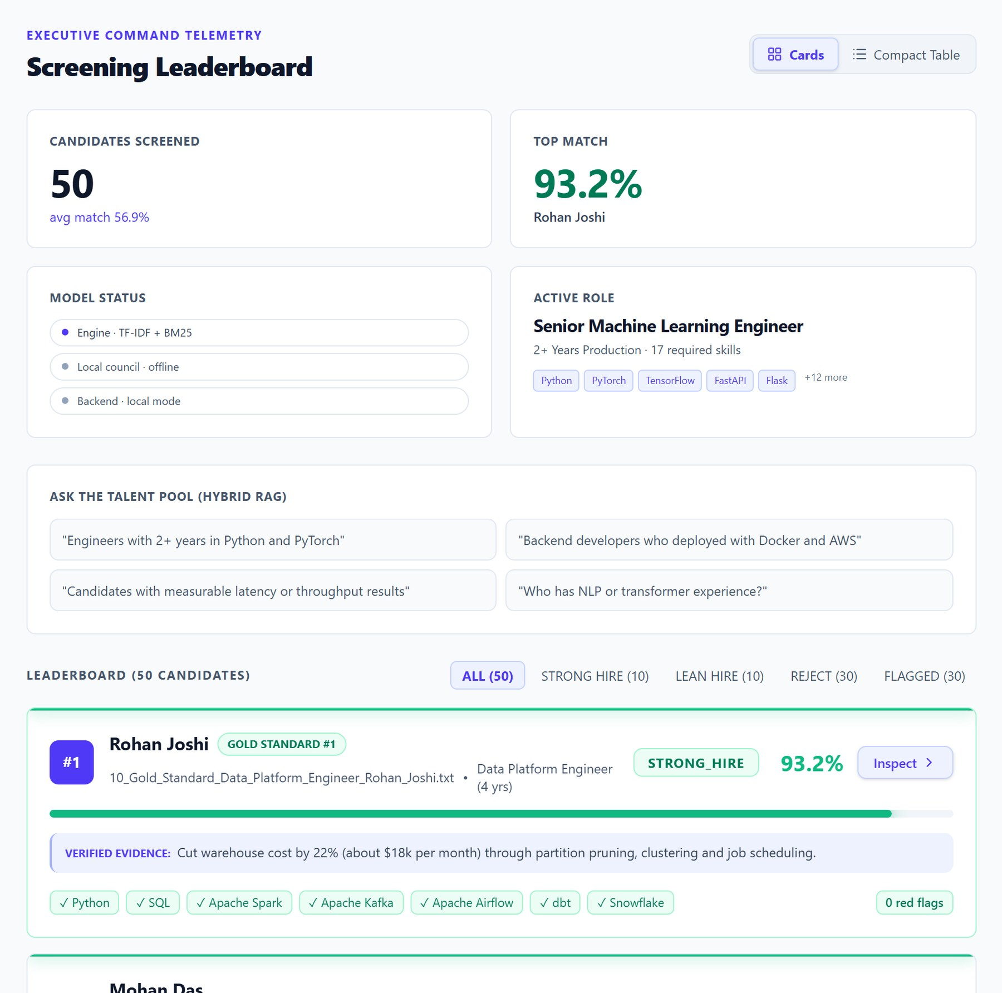
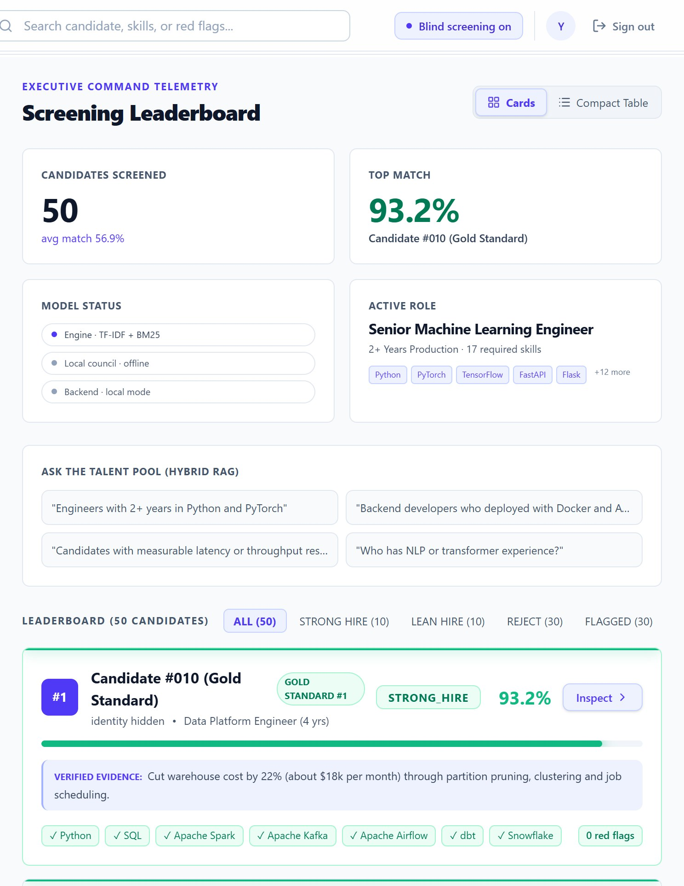
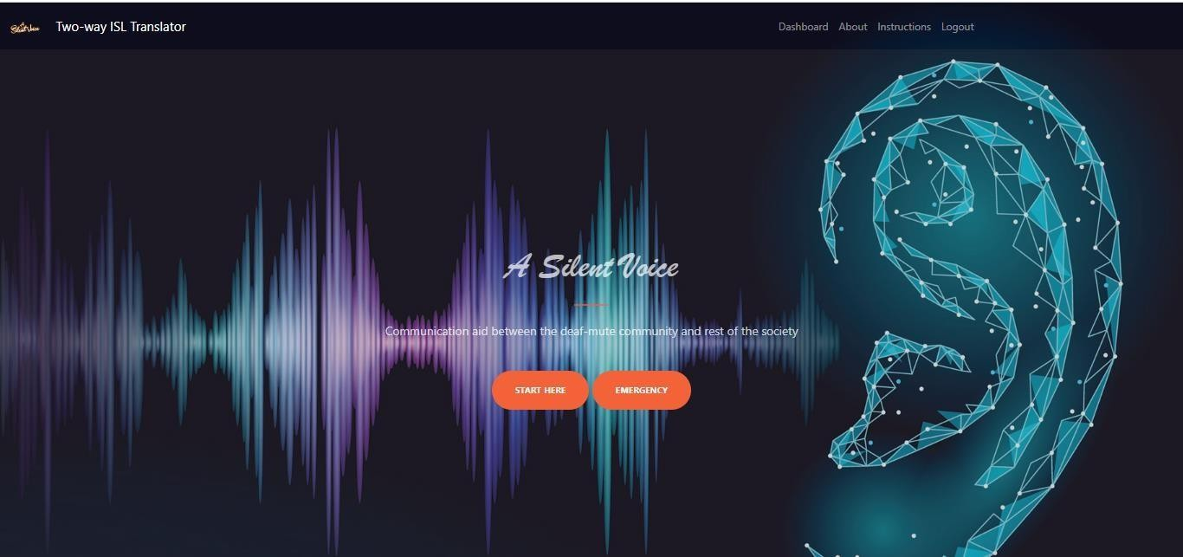
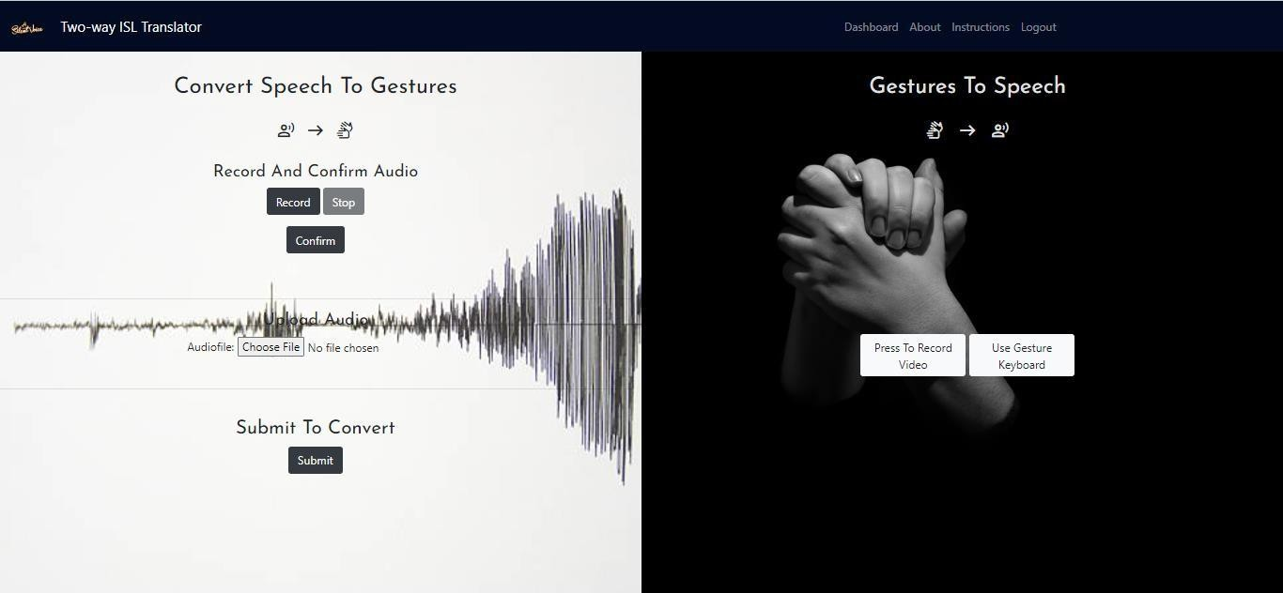
RESULTS (CONTD.)
(a) Leaderboard with verified evidence
(b) Blind screening on: identities hidden
DEPT OF ISE, VKIT
https://vitb.ac.in/

Slide 22
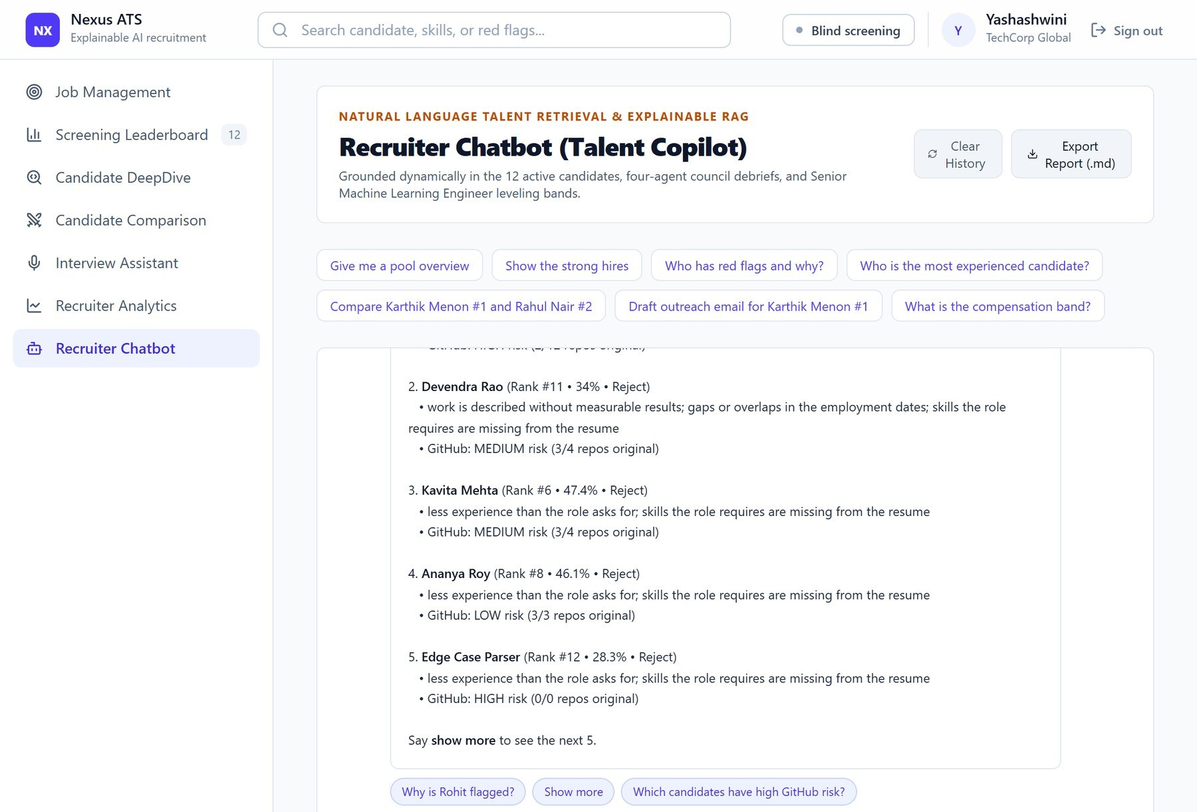
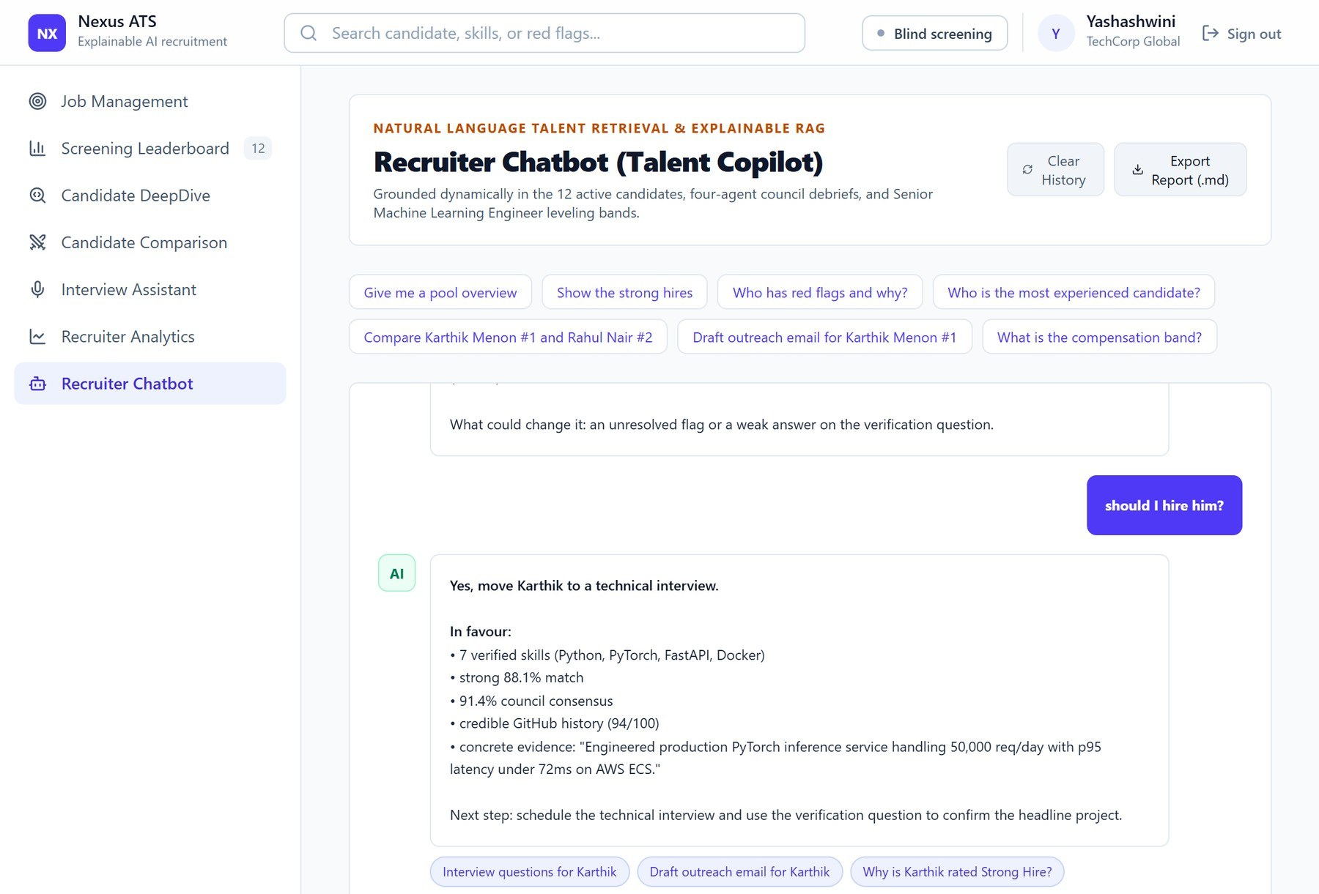
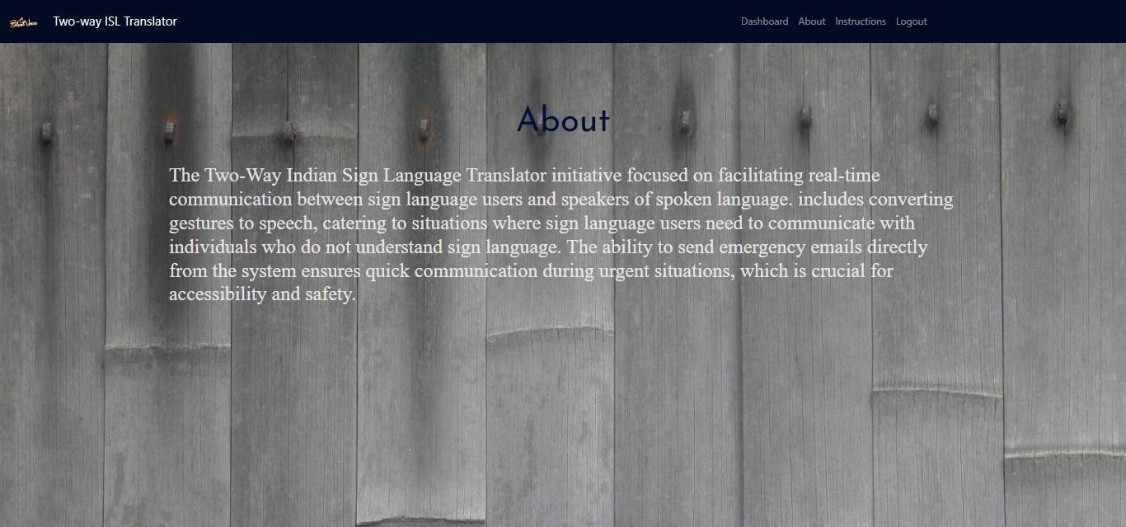
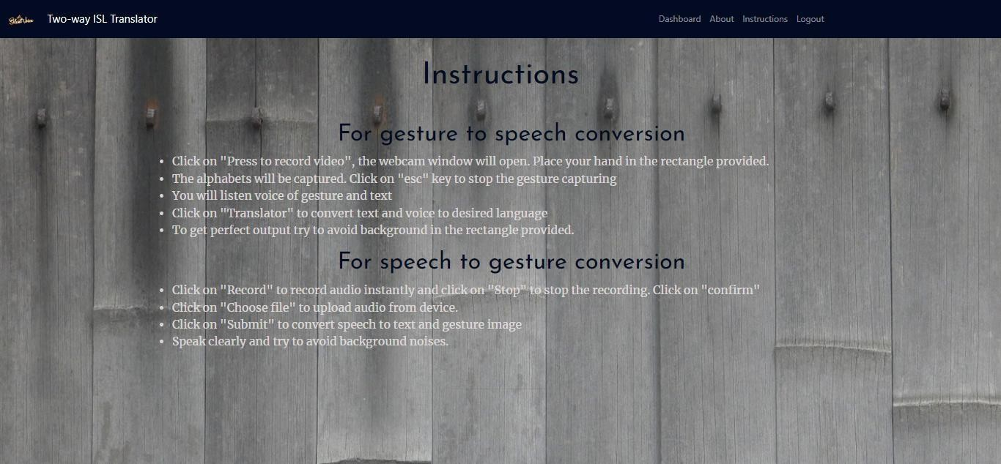
RECRUITER COPILOT
(a) Red-flag audit of the screened pool (b) Follow-up questions with clickable suggestions
DEPT OF ISE, VKIT
https://vitb.ac.in/

Slide 23
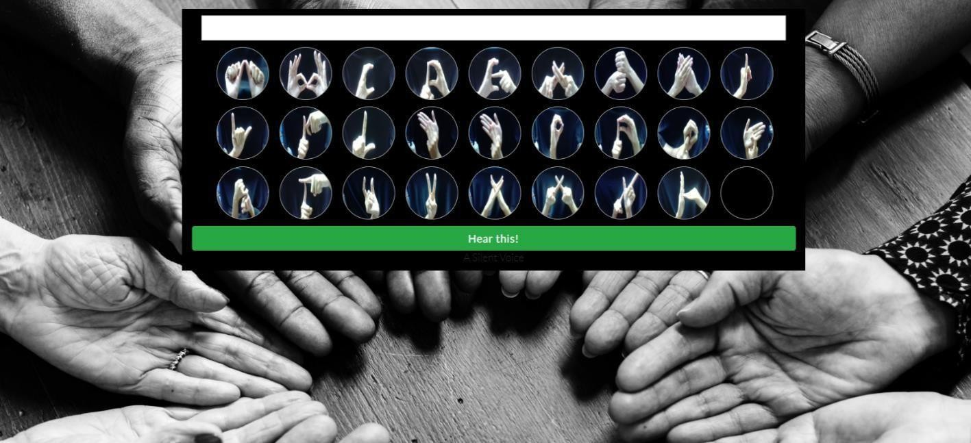
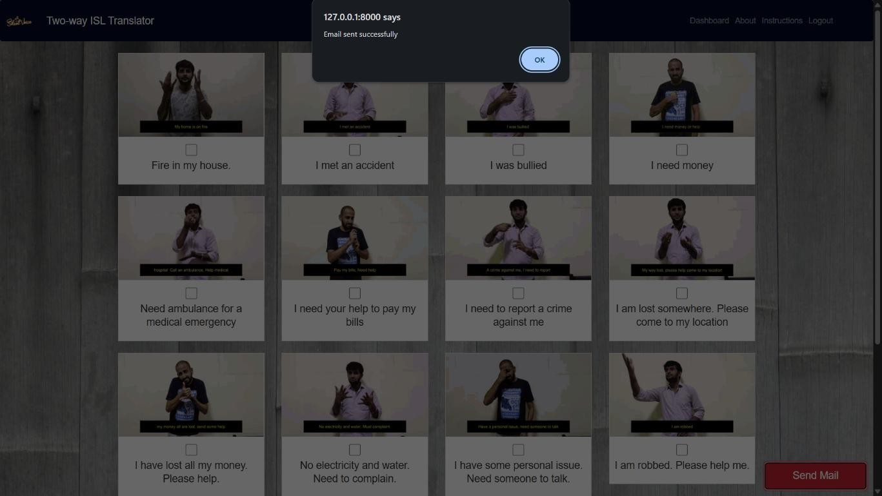
SPEED AND ROBUSTNESS
Fast: about 30 ms per resume end to end, fully offline.
Stable: over 200 random changes to the scoring weights, the top candidate stayed first in every run and the average rank correlation was 0.97.
Fair: swapping names changed no score, in plain or blind mode.
Evidence matters: removing evidence weighting turned two REJECT verdicts into LEAN HIRE.
Different from Phase 1: rank correlation with the keyword baseline is only 0.67, so the ranking really changed.
DEPT OF ISE, VKIT
https://vitb.ac.in/

Slide 24
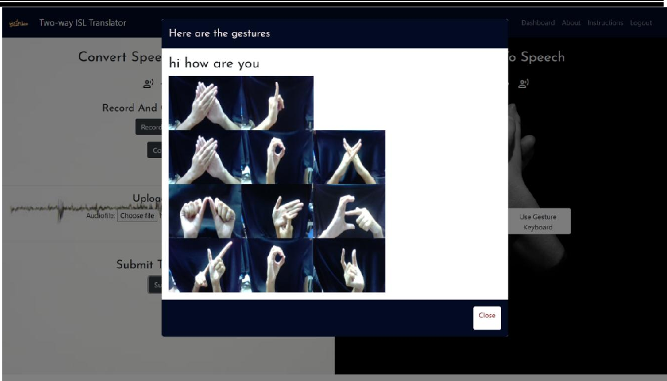
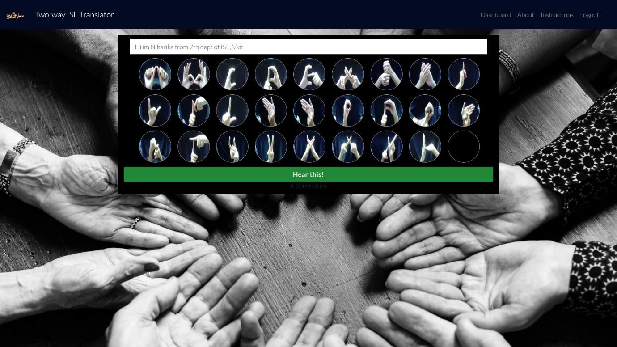
BENCHMARK POOL OF 50 RESUMES
50 synthetic resumes of different types were screened for the Senior Machine Learning Engineer role.
Top match: 93.2%, the gold-standard Data Platform Engineer with zero red flags.
Average match: 56.9% across the pool.
Verdicts: 10 Strong Hire, 10 Lean Hire and 30 Reject; 30 resumes carried at least one red flag.
DEPT OF ISE, VKIT
https://vitb.ac.in/

Slide 25
CONCLUSION
The AI-Powered Intelligent Recruitment System shows that resume screening can be fast, explainable and fair at the same time. It ranks candidates on seven weighted signals instead of simple keyword counts, understands related skills through a skill ontology, and hides identity details through blind screening before anyone is scored.
Every decision comes with a verdict, red flags and a reason, so recruiters can justify it. In testing, the system placed the strong candidate first and rejected resumes with inflated or badly formatted content, while processing each resume in about 30 milliseconds. Changing a candidate's name did not change any score. The system is also deployed as a multi-user web service with server-side authentication and a managed database.
Overall, the project shows that explainable AI can make hiring more transparent, consistent and trustworthy.
DEPT OF ISE, VKIT
https://vitb.ac.in/

Slide 26
FUTURE SCOPE
The deployed system can be extended with role-based access, candidate consent and data-retention controls, and a stored screening history for each account.
A larger set of labelled real hiring data can be used to validate and tune the scoring weights, and the evidence checks can be extended to LinkedIn, portfolios and resumes in more languages.
Email and ATS integrations and a load test would prepare it for production use.
DEPT OF ISE, VKIT
https://vitb.ac.in/

Slide 27
REFERENCES
[1] C. Qin et al., "Enhancing person-job fit for talent recruitment: An ability-aware neural network approach," ACM SIGIR, 2018.
[2] V. Bhatia, P. Rawat, A. Kumar, and R. R. Shah, "End-to-end resume parsing and finding candidates for a job description using BERT," arXiv:1910.03089, 2019.
[3] A. Deshmukh and A. R. Dahake, "Comparing BERT and Sentence-BERT for automated resume screening," IAES Int. J. Artif. Intell., vol. 14, no. 4, 2025.
[4] N. Reimers and I. Gurevych, "Sentence-BERT: Sentence embeddings using Siamese BERT-networks," EMNLP-IJCNLP, 2019.
[5] K. Wilson and A. Caliskan, "Gender, race, and intersectional bias in resume screening via language model retrieval," AAAI/ACM AIES, 2024.
[6] L. Armstrong, A. Liu, S. MacNeil, and D. Metaxa, "The silicon ceiling: Auditing GPT's race and gender biases in hiring," arXiv:2405.04412, 2024.
[7] M. Raghavan, S. Barocas, J. Kleinberg, and K. Levy, "Mitigating bias in algorithmic hiring: Evaluating claims and practices," ACM FAT*, 2020.
[8] M. Zehlike et al., "FA*IR: A fair top-k ranking algorithm," ACM CIKM, 2017.
[9] Y. Du et al., "Improving factuality and reasoning in language models through multiagent debate," ICML, 2024.
[10] C. Qin et al., "A comprehensive survey of artificial intelligence techniques for talent analytics," arXiv:2307.03195, 2023.
DEPT OF ISE, VKIT
https://vitb.ac.in/

Slide 28
THANK
YOU!
DEPT OF ISE, VKIT
https://vitb.ac.in/

